Slide 1
2014 WAGE AND HOUR UPDATE
Presented to PRM Members
by Brian Koji of
Allen, Norton & Blue, P.A.
(813) 251-1210
bkoji@anblaw.com
December 3, 2014

Slide 2
First for the Bad News
Some Sobering Statistics
to Ponder …

Slide 3
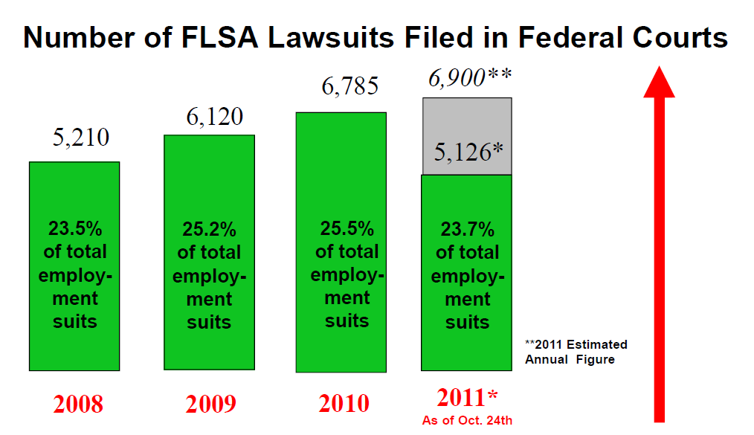
The Wave of Wage & Hour Lawsuits Nationally

Slide 4
Florida Leads the Nation in FLSA Lawsuits
BY FAR!!!!

Slide 5
From 2000 to 2006, FLSA lawsuits rose by 1200% in the Middle District of Florida
43 Lawsuits in 2000
561 Lawsuits as of mid-2006
44% of all FLSA lawsuits Nationwide

Slide 6
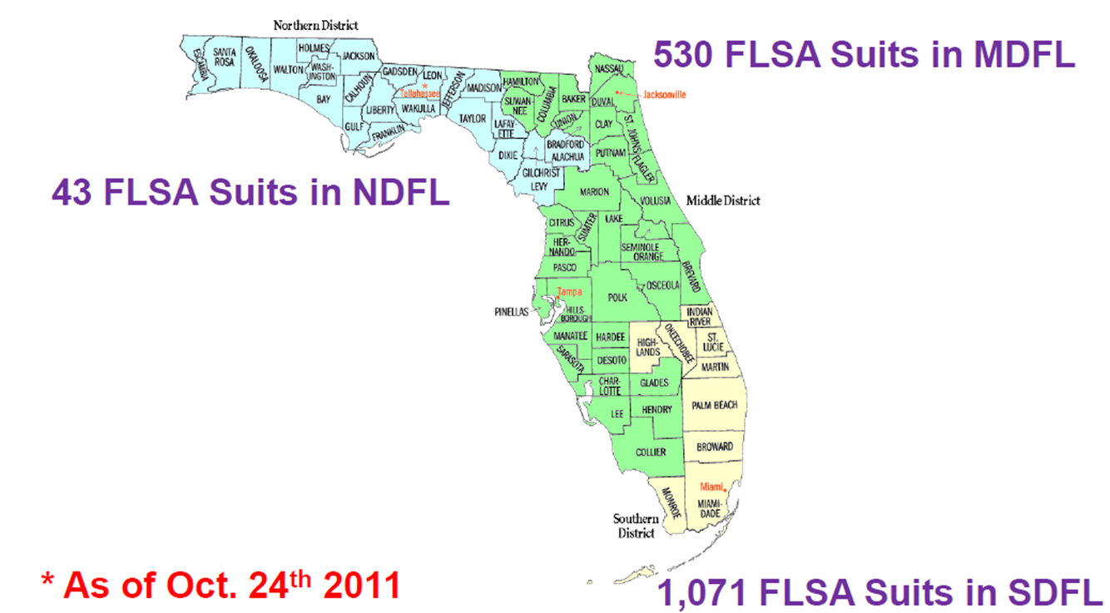
2011

Slide 7
The Trend Has Continued
Percentage of all FLSA Cases
Filed in Florida
2008 → 44.8%
2009 → 34.5%
2010 → 31.7%
2011 → 32.0%*
* As of October 24, 2011

Slide 8
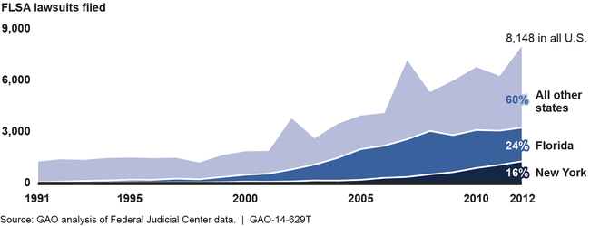
1991-2012

Slide 9
2013 and 2014
FLSA Lawsuits in 2013 once again topped 8,200 Nationwide
We are on pace to set another record in 2014

Slide 10
WHY????

Slide 11
According to the GAO
“Activity on the part of Plaintiffs’ attorneys [is] a significant contributing factor”
Increased “awareness about FLSA cases”
“Fairly straightforward nature of many FLSA cases”

Slide 12
In Other Words
Attorneys’ Fees for the Plaintiff’s Attorney
Easy Settlements in Most Cases
Relatively Little Effort for Plaintiff’s Attorney
Little Risk of Fees Against the Plaintiff
Widespread Marketing by Plaintiffs’ Attorneys

Slide 13
THE GOOD NEWS
By understanding the common problem areas, we can take steps to minimize the risks.

Slide 14
The Problem: Timecards
Timecards that are “too good to be true” because they always show 8 hours for a job that necessitates irregular hours
Timecards with unexplained manual changes

Slide 15
The Problem: Timecards
Timecards or Timesheets done in advance
Timesheets that don’t distinguish between actual working time (i.e., sweat hours) and other paid or unpaid time off

Slide 16
The Solution: Timecards
Vigilance in requiring that employees accurately record all working time
Disclaimer language on timesheets/cards

Slide 17
The Solution: Timecards
Manual changes to timecards should be explained via note or attached memo and acknowledged by the employee
Audit routinely and randomly

Slide 18
The Problem: Unpaid Meal Periods
Automatic Deductions by Payroll for Meals
Employees Working Through Lunch (or not getting an uninterrupted 20-minute period)

Slide 19
The Solution: Unpaid Meal Periods
ELIMINATE Automatic Deductions for Meal Periods
No Eating at Your Desk!
Pay if lunch period is interrupted

Slide 20
The Problem: Reporting Early for Work/Staying Late
Example: Police Department requires all employees be present 15 minutes before shift
Example: Fire Department requires employees stay late to apprise oncoming shift

Slide 21
The Problem: Reporting Early for Work/Staying Late
Employees arrive early for work and “voluntarily” elect to begin early without recording the time
Employees “voluntarily” stay late to finish a task without recording the time

Slide 22
The Solution: Reporting Early for Work/Staying Late
FLSA Regulations require that you pay for all time worked and include it in the calculation of overtime
No such thing as “voluntary” off the clock work

Slide 23
The Solution: Reporting Early for Work/Staying Late
Must pay if you “suffer or permit” the employee to work
You must stop the employee from working or pay for the time, even if it means terminating the employee

Slide 24
The Problem: Not Getting Approval for Overtime
Not paying for overtime and/or not recording the hours worked if the employee does not get approval

Slide 25
The Solution: Not Getting Approval for Overtime
An employer can lawfully require an employee to obtain approval before working overtime
However, if the employee fails to follow the policy, the employer should enforce it through discipline, not by failing to pay for the time

Slide 26
The Problem: Purposeful Rounding
Rounding time worked in a fashion that is always detrimental to the employee (i.e., rounding up start times and rounding down end times)
Requiring employees to begin work early and then rounding

Slide 27
The Solution: Purposeful Rounding
Rounding time worked is permissible so long as it goes both ways (i.e., round to the nearest quarter hour it’ll usually average out)
Employers cannot manipulate pay via rounding practices

Slide 28
The Problem: Averaging Working Time Across Weeks
Example: An employee works 36 hours his week and 44 hours next week, but is only paid for a total of 80 hours that pay period

Slide 29
The Solution: Averaging Working Time Across Weeks
Averaging across work weeks is never permitted, except for police and fire employees who are on an alternative 7(k) schedule
Averaging across 7(k) working periods is not permitted

Slide 30
The Solution: Averaging Working Time Across Weeks
It is permitted to average within a work week (or within a 7(k) work period)
Example: An employee works 2 hours extra on Monday, can be given off 2 hours early later that same week without incurring overtime (since the employee doesn’t go over 40 for the week)

Slide 31
The Problem: Involuntary Volunteers
In the public sector, you may use bona fide volunteers without incurring an obligation to pay them
The problem arises where the volunteering is not voluntary
Example: Requiring through practice or policy that an employee volunteer to be considered for future employment

Slide 32
The Problem: Involuntary Volunteers
Employees volunteering for their employer and performing the same duties as a volunteer that they perform as an employee

Slide 33
The Solution: Involuntary Volunteers
Volunteers may only be compensated for reasonable expenses
If also an employee for the same entity, volunteers cannot be assigned the same or similar duties as a volunteer that they perform as an employee

Slide 34
The Solution: Involuntary Volunteers
Although not unlawful to draw applicants from your volunteer pool, caution should be exercised to ensure that it does not become a “de facto” prerequisite
This should be audited on occasion

Slide 35
The Problem: Incentive Pay, Bonuses, Etc.
Paying compensation but not including it in the regular rate for purposes of calculating overtime compensation

Slide 36
The Solution: Incentive Pay, Bonuses, Etc.
The default rule under the FLSA is that ALL remuneration must be included in the regular rate unless specifically excluded by law
Incentive pay, even if required by law and even if paid by another entity, must be included in the overtime calculation

Slide 37
The Solution: Incentive Pay, Bonuses, Etc.
Shift differentials must be included in regular rate
Non-discretionary bonuses must be included
On Call pay must be included
Commission pay must be included

Slide 38
The Solution: Incentive Pay, Bonuses, Etc.
Generally excludable from regular rate:
Bonuses that are discretionary as to whether they are paid and amount of pay
Daily or Weekly Overtime Premiums
Pay for Certain Time Not Worked (holiday, sick, vacation pay)
Expense reimbursement
Pension contributions

Slide 39
The Problem: Not Paying for Certain Travel Time
Employees who are required to report to a specific location, but are not paid until they report to another job site

Slide 40
The Solution: Not Paying for Certain Travel Time
FLSA regulations provide that travel that is “all in a day’s work” is compensable
Travel from job site to job site must be recorded and paid
Home to work travel is not generally compensable

Slide 41
The Solution: Not Paying for Certain Travel Time
If you require the employee to report to one site (i.e., to pick up tools or get assignments) before going to another job site, you must compensate from time the employee arrives as the first site

Slide 42
The Problem: Preliminary and Postliminary Activities
Not paying for time spent donning and doffing safety gear or other similar specialized gear
Not paying for time for activities such as going through security

Slide 43
The Solution: Preliminary and Postliminary Activities
Is the activity a “principal” activity or “integral and indispensable to a principal activity?
If so, it is compensable
All working tasks from the first principal activity to the last activity are generally compensable
In contrast, activities that are preliminary or postliminary are not compensable

Slide 44
Other Tips to Minimize Risk
For salaried exempt employees, implement a policy prohibiting unlawful salary deductions, with a complaint procedure
Routine checks and audits of exemptions, employee status, time cards, overtime calculations

Slide 45
SAMPLE POLICY
PROHIBITION ON IMPROPER SALARY DEDUCTIONS
It is the City’s policy to comply with all applicable wage and hour laws and regulations. In accordance with this policy, the City prohibits deductions from the salary of exempt employees except where otherwise permitted by law.
If you believe that an improper deduction has been made to your salary, you must immediately report it to the Director of Human Resources. Reports of improper deductions will be promptly investigated and, if it is determined that an improper deduction was made, the deduction will be reimbursed.

Slide 46
Employee Remedies - Penalties
Injunctive Relief (rare except for retaliation cases)
Back Wages (not for more than 2 years, or for willful violations 3 years)
Liquidated Damages (discretionary where employer cannot show good faith)
Prejudgment Interest (not recoverable in 11th Circuit)
Attorney’s Fees (reasonable)
Criminal: Fines and Imprisonment (if willful violation proven)

Slide 47
Thank You
For questions, comments, criticisms, or suggestions, please give me a call at (813-251-1210) or send me an email at bkoji@anblaw.com.

