Slide 1
Accommodating LGBT Employees: What Every Employer Needs To Know

Slide 2
Presenter

Slide 3
Session Objectives

Slide 4
Defining Terms

Slide 5
Defining Terms

Slide 6
When is an Employee Considered Transgender?

Slide 7
Growing State and Federal Law

Slide 8
Local Law

Slide 9
Equal Employment Opportunity Commission

Slide 10
Equal Employment Opportunity Commission

Slide 11
Equal Employment Opportunity Commission

Slide 12
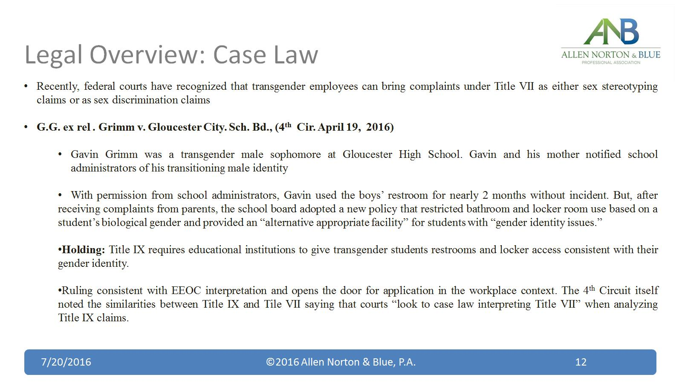
Legal Overview: Case Law

Slide 13
Legal Overview: Case Law

Slide 14
Legal Overview: Case Law

Slide 15
Legal Overview: Case Law

Slide 16
Legal Overview: Case Law

Slide 17
Legal Overview: What Does this Mean for Employers?

Slide 18
What is the Next Step?

Slide 19
Implementing Nondiscriminatory Policies

Slide 20
3 Principles to Follow

Slide 21
Restroom Accessibility

Slide 22
Restroom Accessibility

Slide 23
Preferred Names and Pronouns

Slide 24
Preferred Names and Pronouns

Slide 25
Name Change on Official Documents and Records

Slide 26
Appearances and Dress Code Standards

Slide 27
Leave Benefits

Slide 28
Confidentiality and Respectful Disclosure

Slide 29
Notifying Employee’s of Coworker’s Transition

Slide 30
Notifying Employee’s of Coworker's Transition

Slide 31
Communicating with Coworkers

Slide 32
Addressing Concerns of Coworkers

Slide 33
Develop a Customized Transition Plan

Slide 34
Develop a Customized Transition Plan

Slide 35
Same-Sex Marriage and Health Benefits

Slide 36
Same-Sex Marriage and Health Benefits

Slide 37
Preventing Harassment Against LGBT Employees

Slide 38
Preventing Harassment Against LGBT Employees

Slide 39
Things to Remember

Slide 40
Thank You

